Slide 1

Hunting Systems with HELK
Detecting Bad things on Windows continued...

Slide 2
Why Workshop???
Bring people together to tackle Cybersecurity issues
-Provide Step-By-Step solution. Aka Sysmon logging and HELK centralized logging
Provide Advising while in workshop
-Provide UW resources such as UW-IT Sophos Central, Firewalls, WuFB, SCCM, etc
-Provide Security Advocates info for MSFT-Teams, Threat Report, CIS resources, etc
- Provide UW APS awareness (Logging/Monitoring) , Incident Response page, Security Planning, Critical Assets awareness, provide security strategies, etc
Create relationships (trust) at UW far reaching workshop

Slide 3
HELK? What is that?
Hunting, Elasticsearch, Logstash, Kibana
-Elasticsearch is a distributed search and analytics engine
-Logstash is a data processing pipeline that allows you to collect data from a variety of sources
-Kibana lets you visualize your Elasticsearch data

Slide 4
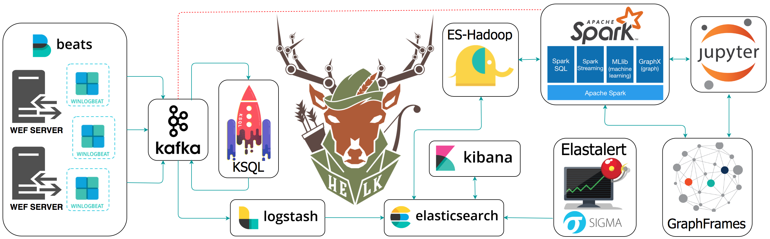
HELK Illustration...
Notes:
Kafka handles real time data feeds
Ksql creates db of continually updated fields (transformations).. Join tables etc.
ES-Hadoop is used to efficiently store and process large datasets ranging in size from gigabytes to petabytes of data. Hadoop allows clustering multiple computers to analyze massive datasets in parallel more quickly.
Elastalert is combined with ElasticSearch and two other components--> rule types and alerts.
ApacheSpark utilizes in-memory caching, and optimized query execution for fast analytic queries against data of any size.
GraphFrames is a package for Apache Spark which provides DataFrame-based Graphs
Machine learning via Jupyter notebooks
Snap.io DetectionLab is another avenue.
Events per second....EPS

Slide 5
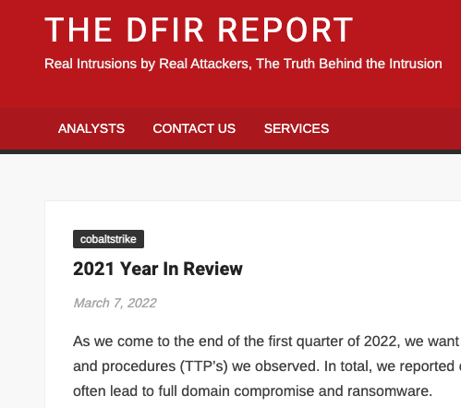
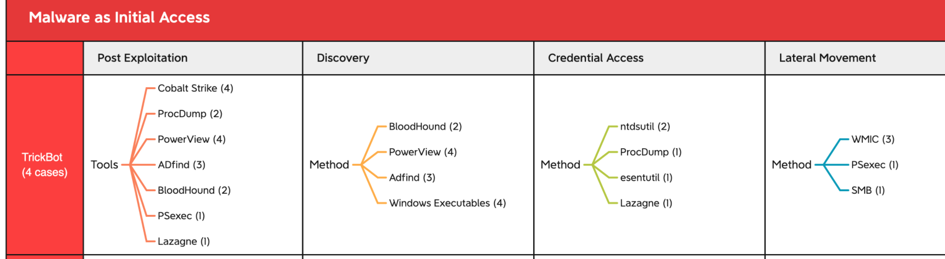
Industry Awareness https://thedfirreport.com/2022/03/07/2021-year-in-review/
Notes:
https://thedfirreport.com/2022/03/07/2021-year-in-review/

Slide 6
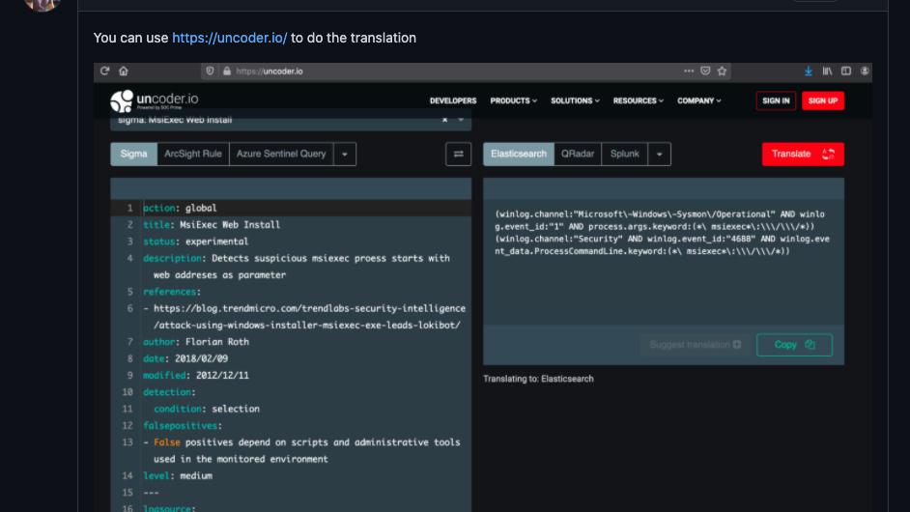
Notes:
Uncoder.IO | Universal Sigma Rule Converter for SIEM, EDR, and NTDR
https://thedfirreport.com/2022/03/07/2021-year-in-review/
Need the reason for the alert and 5 steps you would do if it went off.
sigma rules on HELK · Issue #511 · Cyb3rWard0g/HELK · GitHub
One issue with that of course is that the translation uses ECS standardization. Make sure you use the right field names with HELK
add your sigma rule to the rules folder, or within the docker container by getting into via sudo docker exec -ti helk-elastalert bash
sigma/rules at master · SigmaHQ/sigma (github.com)
Search · clear (github.com)
sigma/proc_creation_win_susp_eventlog_clear.yml at 8bb3379b6807610d61d29db1d76f5af4840b8208 · SigmaHQ/sigma (github.com)
More about Sigma: thomaspatzke/sigma-workshop: Elasticsearch/Kibana environment and log data for Sigma workshop (github.com)
What the HELK? SIGMA integration via Elastalert | by Roberto Rodriguez | Posts By SpecterOps Team Members
jessefmoore/CloudLabsAD: Terraform + Ansible deployment scripts for an Active Directory lab environment. (github.com)

Slide 7
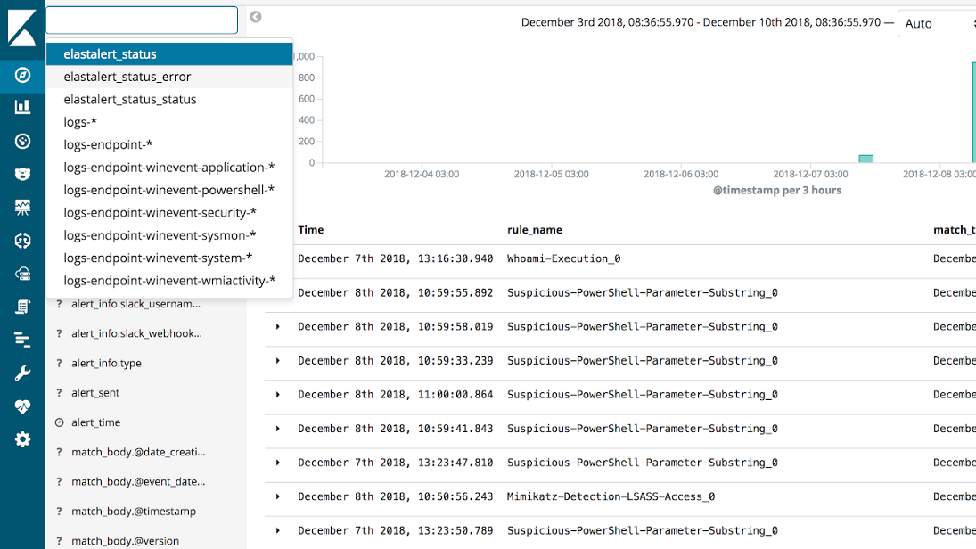
Notes:
What the HELK? SIGMA integration via Elastalert | by Roberto Rodriguez | Posts By SpecterOps Team Members

Slide 8
Access info...
My UW OneDrive space has the additional info for participants
Future state?
Accessible via the world on ciso.uw.edu
OR UW Confluence.
OR Shared UW CISO SharePoint

Slide 9
APS Things that make you go HMM?
MINIMUM STANDARDS. ---> APS translated by me on Logging & Monitoring
GUIDANCE FROM CISO OFFICE ---> Security "Technical" Advising
IDENTIFICATION OF SERVICES FROM UW-IT ---> EDR Sophos Central, etc
ROLES AND RESPONSIBILITIES TO INCLUDE MONITORING/TRACKING ---> InfoSecurity Incidents & Privacy reporting
Notes:
APS 2.4, Information Security and Privacy: Roles, Responsibilities, and Definitions (washington.edu)
UW Policies – Office of the Chief Information Security Officer
UW-IT Service Catalog | IT Connect
Report an Incident – Office of the Chief Information Security Officer (uw.edu)

Slide 10

Questions?
Notes:
-Sysmon logging – Linux
Sysmon for Linux Test Drive - Lares

